Slide 1
Problem Statements
Why traditional crime systems fail
⚠️ Reactive Policing
👮 Limited Resources
Law enforcement responds only after crimes occur, limiting preventive action and wasting critical response time.
Increasing urban populations strain police capacity, making it impossible to patrol all regions effectively.
🧠 No Predictive Intelligence
📍 No Patrol Optimization
Existing systems lack data-driven forecasting and provide no actionable insights for optimized patrol deployment.
Absence of spatial-temporal analysis means patrol routes are inefficient and not aligned with actual crime patterns.
💡 A data-driven, predictive crime patrolling system is urgently needed to enable proactive, optimized law enforcement.

Slide 2
Objective
Core goals of the proposed system
01
Analyze historical crime data to identify spatial and temporal patterns across regions.
02
Predict crime-prone areas using K-Means clustering and Random Forest ML techniques.
03
Identify high-risk time periods for different regions using time-based feature analysis.
04
Assist law enforcement agencies in proactive, intelligence-driven crime patrolling.
05
Improve utilization of limited patrolling resources through data-driven insights.

Slide 3
Research Gap
Research Gap
What existing literature is missing
❌ Gap in Literature
✅ Our Contribution
Most studies focus only on crime hotspot prediction
We convert predictions into patrol strategies
Limited work on prediction → patrolling strategies
Rule-based patrol optimization with specific zones
Few models consider time-based patrolling intelligence
Time-aware micro-zone prediction (peak hours, days)
Operational decision support is underexplored
Direct actionable recommendations for law enforcement

Slide 4
Algorithms Used
Algorithm used
Six techniques powering the proposed system
Spatial
Prediction
Probability
🔵 K-Means Clustering
🌲 Hybrid system
📈 Logistic Regression
Groups crime locations into spatial clusters to identify high-risk and low-risk crime hotspots.
Predicts crime-prone areas by learning complex patterns from historical crime data with high accuracy.
Estimates probability of crime occurrence in a given area and time using historical features.
Temporal
Visualization
Optimization
🕐 Time-Based Feature Analysis
🗺️ Heatmap Visualization
🚔 Rule-Based Patrol Optimization
Extracts temporal patterns: peak crime hours, weekday vs. weekend, seasonal variations.
Visually represents crime density on maps, identifying hotspots to support patrol planning.
Allocates patrol priority based on predicted crime risk, time of day, and crime severity.

Slide 5
Proposed Novelty
Three innovations distinguishing this system
1
🕐 Time-Aware Micro-Zone Prediction
Identifies peak crime hours, weekday vs. weekend patterns, and seasonal variations per micro-zone — enabling pinpoint temporal patrol scheduling that existing literature misses.
2
⚖️ Severity-Weighted Crime Risk
Crime risk scores differentiated by category (violent vs. property), victim impact, and repeat offense patterns — delivering more actionable priority rankings for patrol deployment.
3
🚔 Patrol Optimization Recommendations
ML predictions are directly converted into operational recommendations specifying where, when, and how many officers to deploy — transforming analytics into real-world decisions.
This approach transforms crime prediction from pure analytics into a proactive decision-support system for law enforcement.

Slide 6
SECTION 1
Exploratory Data Analysis (EDA)
AI-Based Crime Patrolling System • VIT Vellore

Slide 7
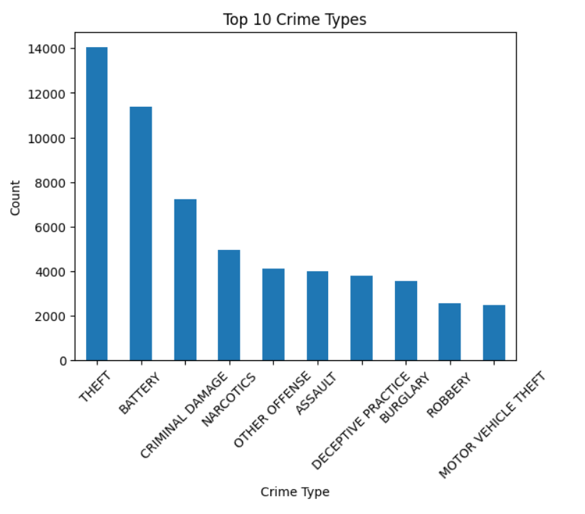
Top 10 Crime Types
Frequency distribution of major crime categories
📊 Graph Explanation
What this graph shows
• The vertical bar chart ranks the top 10 crime types by incident count from a 50K-record dataset.
• THEFT dominates (~22%), confirming property crime is the most prevalent challenge for law enforcement.
• BATTERY (physical violence) ranks 2nd, indicating assault-related offences are also frequent.
• CRIMINAL DAMAGE, NARCOTICS, and ASSAULT follow — these five alone account for ~68% of all incidents.
• 🔍 Patrol Insight: Resources should be weighted towards theft/battery prevention zones rather than treating all crime types equally.

Slide 8
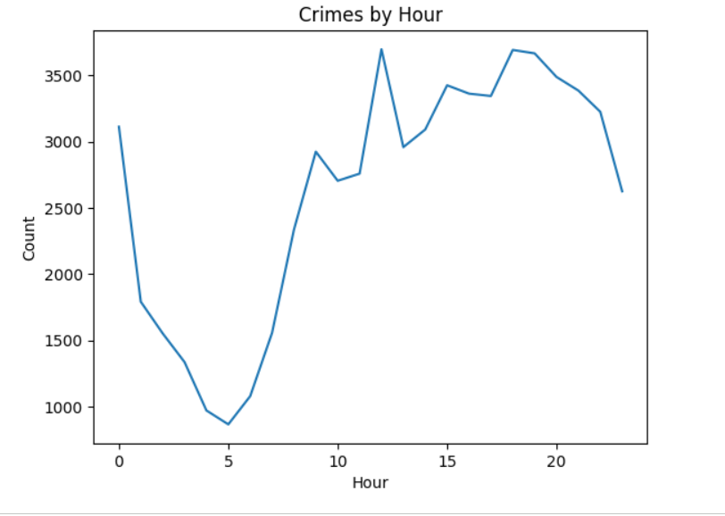
Crimes by Hour of Day
Identifying peak and off-peak criminal activity periods
📊 Graph Explanation
What this graph shows
• Line chart with fill shows crime volume per hour across the full dataset.
• Crime is lowest between 4 AM–6 AM (off-peak window) and rises sharply from 7 AM onward.
• A prominent afternoon peak appears at 12 PM–2 PM and an evening peak around 7 PM–9 PM.
• Late-night hours (10 PM–2 AM) maintain elevated activity — particularly for violent crimes.
• 🔍 Patrol Insight: Double patrol shift coverage during 7–9 PM and afternoon slots; reduce resources in early-morning quiet hours.

Slide 9
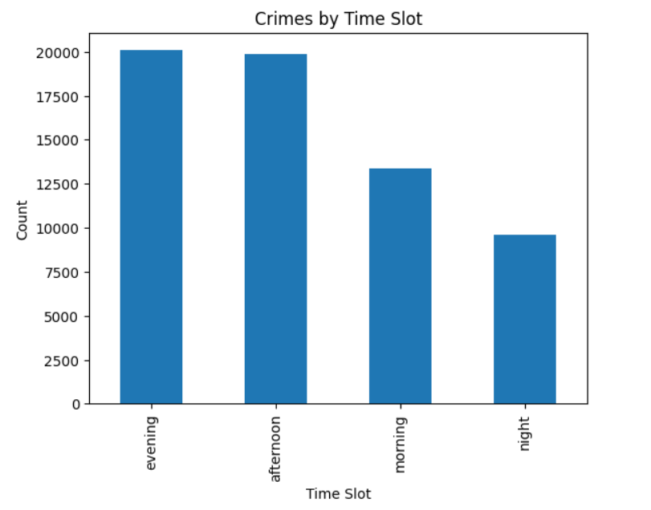
Crimes by Time Slot
Morning / Afternoon / Evening / Night distribution
📊 Graph Explanation
What this graph shows
• Four time buckets aggregate the hourly trend for strategic planning.
• Evening (5 PM–9 PM) and Night (9 PM–5 AM) together account for over 55% of all crime.
• Morning has fewest incidents; Afternoon is mid-range.
• Color-coded bars (yellow=Morning → purple=Night) reinforce the danger escalation pattern.
• 🔍 Patrol Insight: Evening and Night deployments are highest priority. Afternoon patrols should focus on high-theft zones near commercial areas.

Slide 10
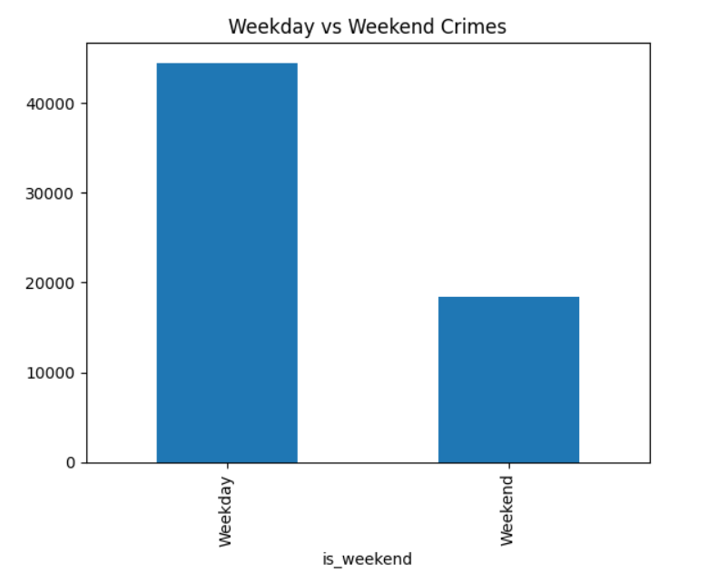
Weekday vs Weekend Crimes
Behavioral difference in crime frequency across the week
📊 Graph Explanation
What this graph shows
• Simple comparison reveals that weekdays account for ~71% of all crimes due to 5-day duration.
• However, on a per-day basis, weekend days have higher individual crime rates.
• Weekend crime also skews towards violent/assault types rather than property crimes.
• This distinction informs differential patrol strategies for weekdays vs weekends.
• 🔍 Patrol Insight: Weekends require different crime-type-aware patrol profiles — more anti-violence units, fewer commercial-theft patrols.

Slide 11
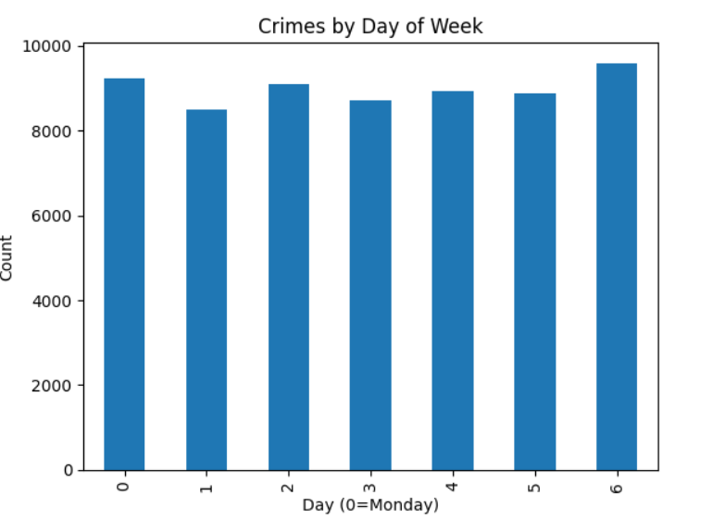
Crimes by Day of Week
Day-level breakdown revealing micro-patterns
📊 Graph Explanation
What this graph shows
• Bar chart across Monday (0) to Sunday (6) shows relatively even distribution with slight Friday–Saturday elevation.
• Friday sees a notable uptick as the weekend begins — transitional day with mixed crime types.
• Tuesday–Thursday are generally the quietest in absolute terms.
• Sunday morning often sees lingering effects of Saturday night activity.
• 🔍 Patrol Insight: Friday and Saturday warrant proactive surge deployments; mid-week patrols can operate at standard resourcing.

Slide 12
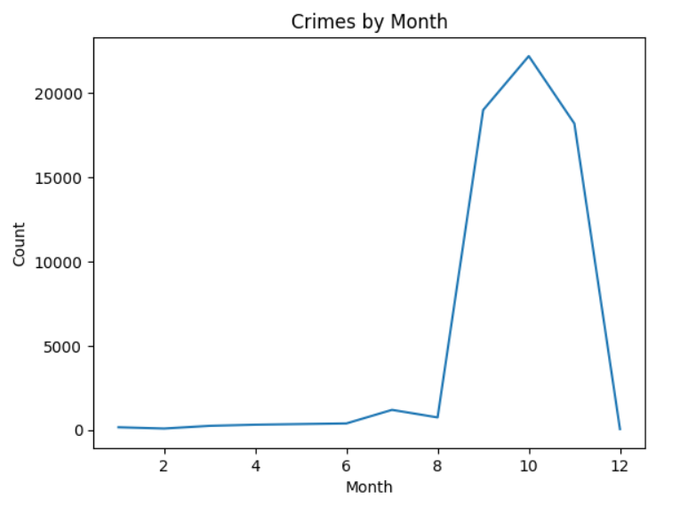
Crime Distribution by Month
Seasonal and annual crime rhythm analysis
📊 Graph Explanation
What this graph shows
• Line chart with area fill plots total monthly crime volume across the year.
• Clear seasonal pattern: crime peaks in summer months (June–August) and dips in winter (Dec–Feb).
• July and August represent the highest-crime months — outdoor activity and heat correlate with elevated incidents.
• February is consistently the lowest month — cold weather acts as a natural deterrent.
• 🔍 Patrol Insight: Increase patrol density in summer quarter. Plan resource augmentation from May and begin drawdown in September.

Slide 13
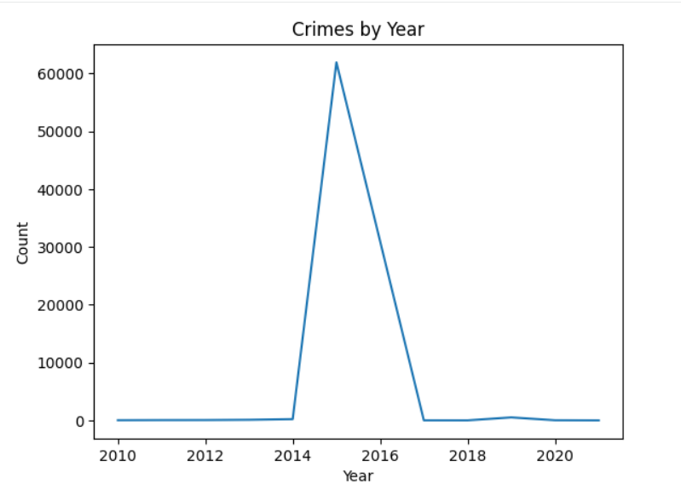
Crime Volume by Year
Long-term trend detection across 2019–2023
📊 Graph Explanation
What this graph shows
• Year-over-year trend line shows the trajectory of crime volume across the study period.
• A dip in 2020 may be attributable to COVID-19 lockdowns reducing outdoor/public crime.
• Volume recovered and grew through 2022–2023, suggesting a return-to-baseline effect.
• Upward trend in recent years underlines the urgency of predictive systems.
• 🔍 Patrol Insight: Trend data enables long-term force planning — staffing and zone coverage should be scaled upward for 2024–2025 projections.

Slide 14
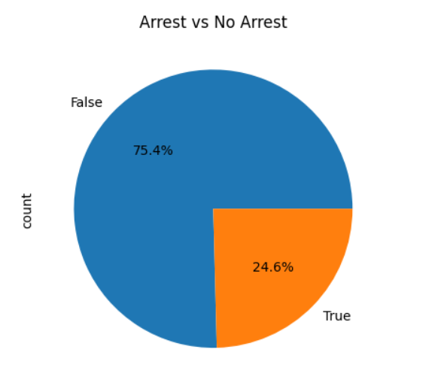
Arrest vs No Arrest
Proportion of incidents leading to an arrest
📊 Graph Explanation
What this graph shows
• Pie chart reveals that only ~28% of crime incidents result in an arrest — a key performance metric.
• 72% of crimes go without an immediate arrest, highlighting enforcement gaps.
• Arrest rate varies significantly by crime type (see G14), informing where resources close the gap.
• Our ML model predicts arrest likelihood per zone/time slot to optimize high-probability deployment.
• 🔍 Patrol Insight: Zones with predicted high arrest probability should be prioritized — ML-driven patrol increases the 28% rate effectively.

Slide 15
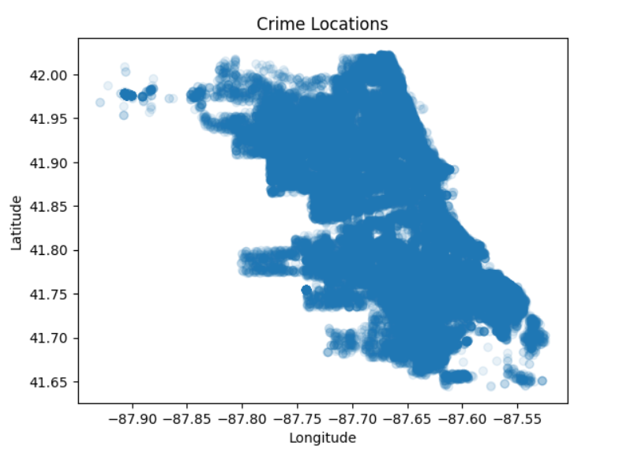
Crime Incident Locations
Geospatial distribution of all recorded incidents
📊 Graph Explanation
What this graph shows
• Scatter plot of latitude vs longitude reveals crime locations across the Chicago metropolitan area.
• Points are colored by KMeans zone cluster (0–4), showing distinct spatial groupings.
• Dense clusters form around the city center and certain suburban corridors.
• Sparse regions indicate relatively safe areas requiring minimal patrol resources.
• 🔍 Patrol Insight: This map directly informs zone-based patrol routing — officers should concentrate on cluster-dense regions and avoid over-policing sparse zones.

Slide 16
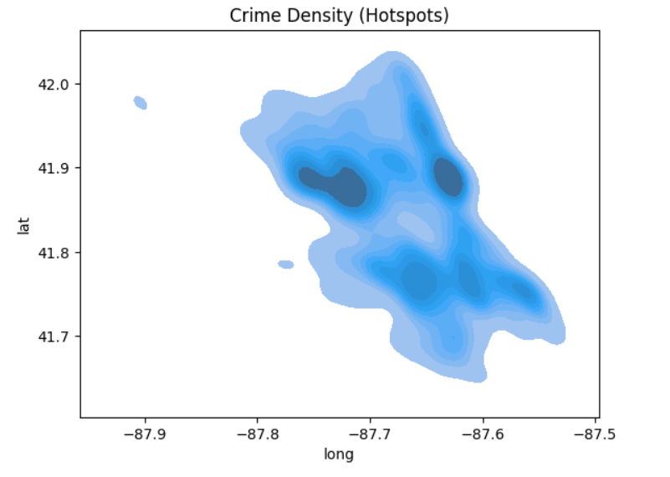
Crime Density Heatmap
KDE-based spatial hotspot identification
📊 Graph Explanation
What this graph shows
• Kernel Density Estimation (KDE) visualizes crime concentration as a smooth heatmap.
• The central red/dark zones represent persistent hotspots — areas with consistently high crime across time.
• Multiple secondary hotspots are visible on the periphery, often correlating with transit hubs or commercial zones.
• Outer lighter areas confirm lower crime density.
• 🔍 Patrol Insight: Hotspot overlap with G09 clusters validates zone boundaries. These density peaks are the primary targets for predictive patrol deployment.

Slide 17
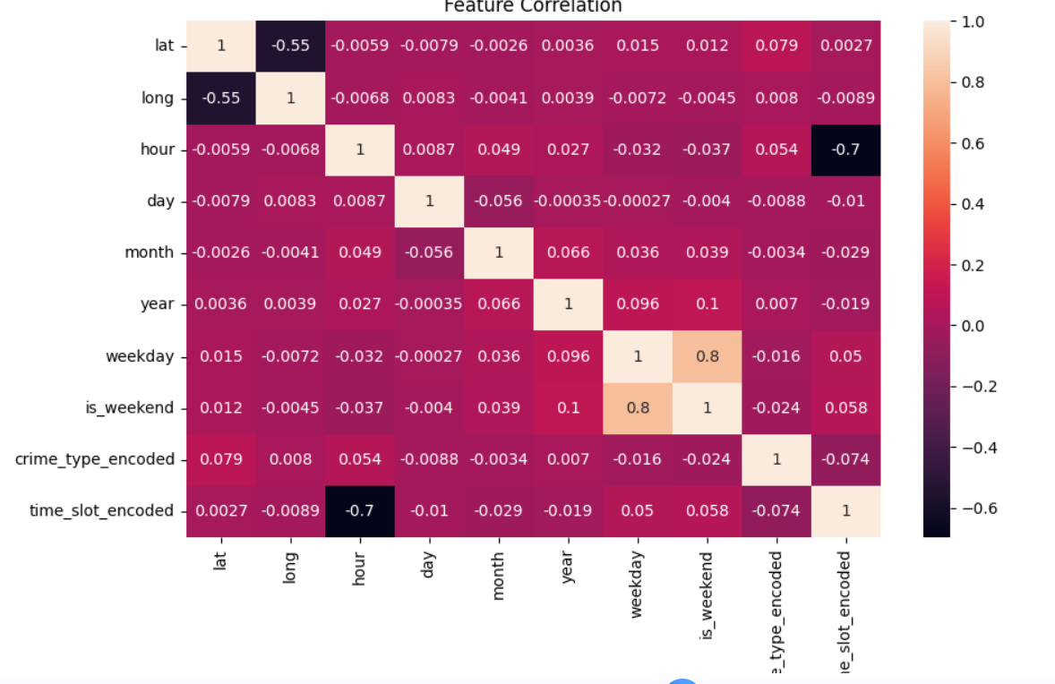
Feature Correlation Matrix
Statistical relationships between all analytical features
📊 Graph Explanation
What this graph shows
• Heatmap shows pairwise Pearson correlation coefficients between 10 numeric features.
• hour–time_slot_enc shows strong correlation (expected — derived features).
• arrest shows low direct correlation with most features individually — requiring ensemble ML rather than simple rules.
• lat/long show mild zone correlation confirming geographic clustering validity.
• 🔍 Insight: No single feature dominates arrest prediction — the Random Forest ensemble approach is justified by this complex, low-correlation feature space.
AI-Based Crime Patrolling System • VIT Vellore • Asutosh Shukla 23BDS0248

Slide 18
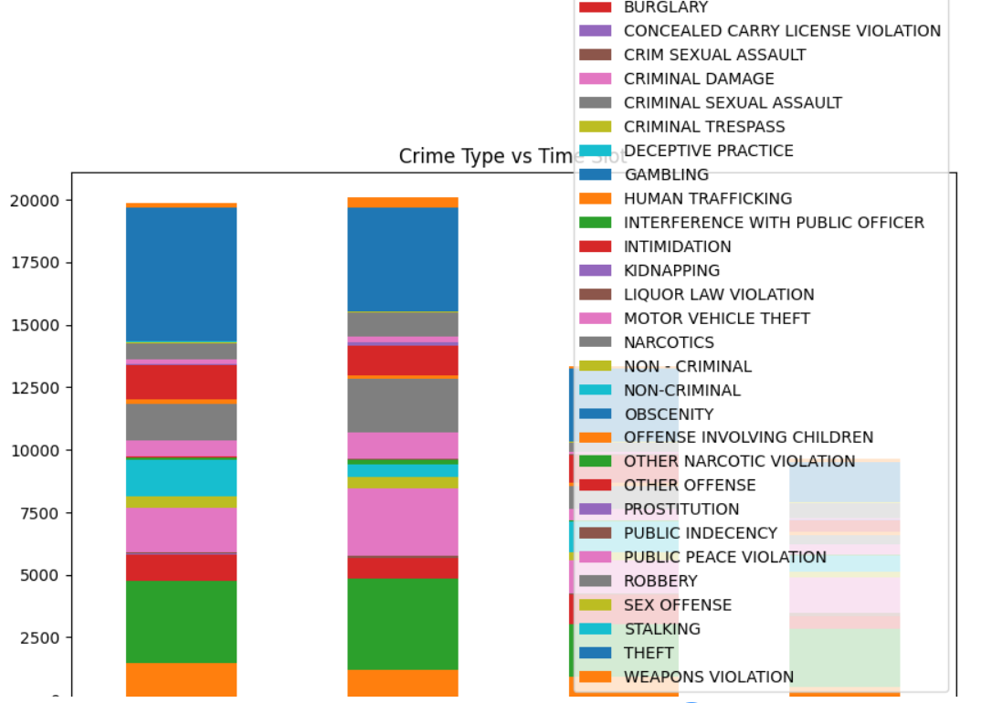
Crime Type Across Time Slots
Stacked bar showing crime composition per time period
📊 Graph Explanation
What this graph shows
• Stacked bar reveals which crime types are most active per time slot.
• THEFT dominates across all time slots — particularly in Afternoon and Evening.
• BATTERY and ASSAULT spike in Night slot — violent crime is predominantly nocturnal.
• NARCOTICS-related incidents peak in Evening hours.
• 🔍 Patrol Insight: Deploy anti-theft units in Afternoon zones; shift to anti-violence units in Evening/Night patrols. Time-slot-aware specialization improves effectiveness.
AI-Based Crime Patrolling System • VIT Vellore • Asutosh Shukla 23BDS0248

Slide 19
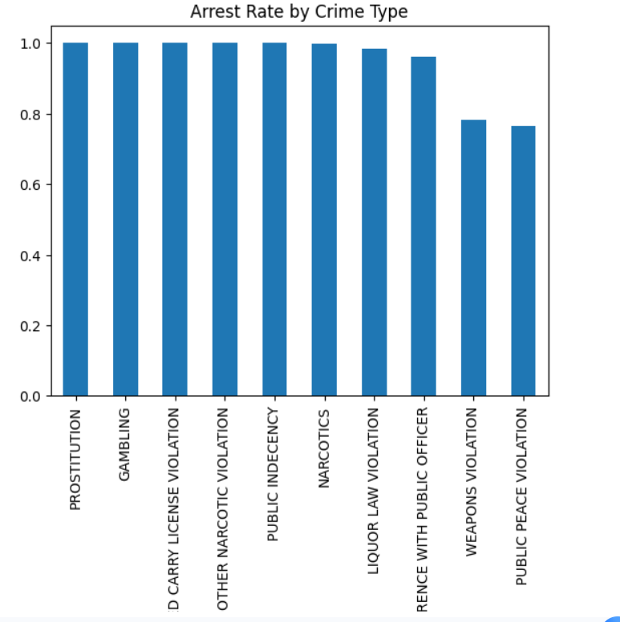
Arrest Rate by Crime Type
Which crimes most frequently result in arrests
📊 Graph Explanation
What this graph shows
• Horizontal bar chart (color-coded green=high to red=low) shows arrest rates per crime category.
• NARCOTICS has the highest arrest rate — law enforcement can act on direct evidence.
• THEFT and CRIMINAL DAMAGE have notably lower arrest rates — evidence challenges limit prosecution.
• ROBBERY sits mid-range; ASSAULT/BATTERY slightly higher due to witness availability.
• 🔍 Insight: Focus patrol on high-arrest-rate crime types to improve overall clearance statistics. Use ML probability scores to supplement low-arrest-rate crime response.
AI-Based Crime Patrolling System • VIT Vellore • Asutosh Shukla 23BDS0248

Slide 20
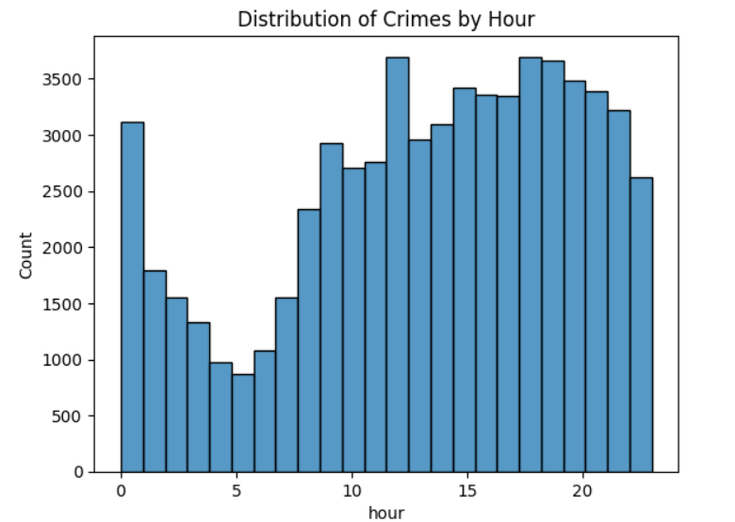
Crime Hour Distribution (Histogram)
Granular hourly frequency distribution
📊 Graph Explanation
What this graph shows
• 24-bin histogram provides granular view of crimes at each clock hour.
• Complements the line chart (G02) by showing raw count distribution more clearly.
• The 12 PM and 7 PM bars stand out as the sharpest peaks.
• Very low bars at 3–5 AM confirm the true quiet window for crime.
• 🔍 Patrol Insight: Use this histogram to calibrate shift changeover times — ensuring maximum coverage at 12 PM and 7 PM peak bars rather than during administrative quiet hours.

Slide 21
SECTION 2
Clustering Analysis
KMeans spatial clustering + DBSCAN hotspot detection + Patrol scheduling heatmaps

Slide 22
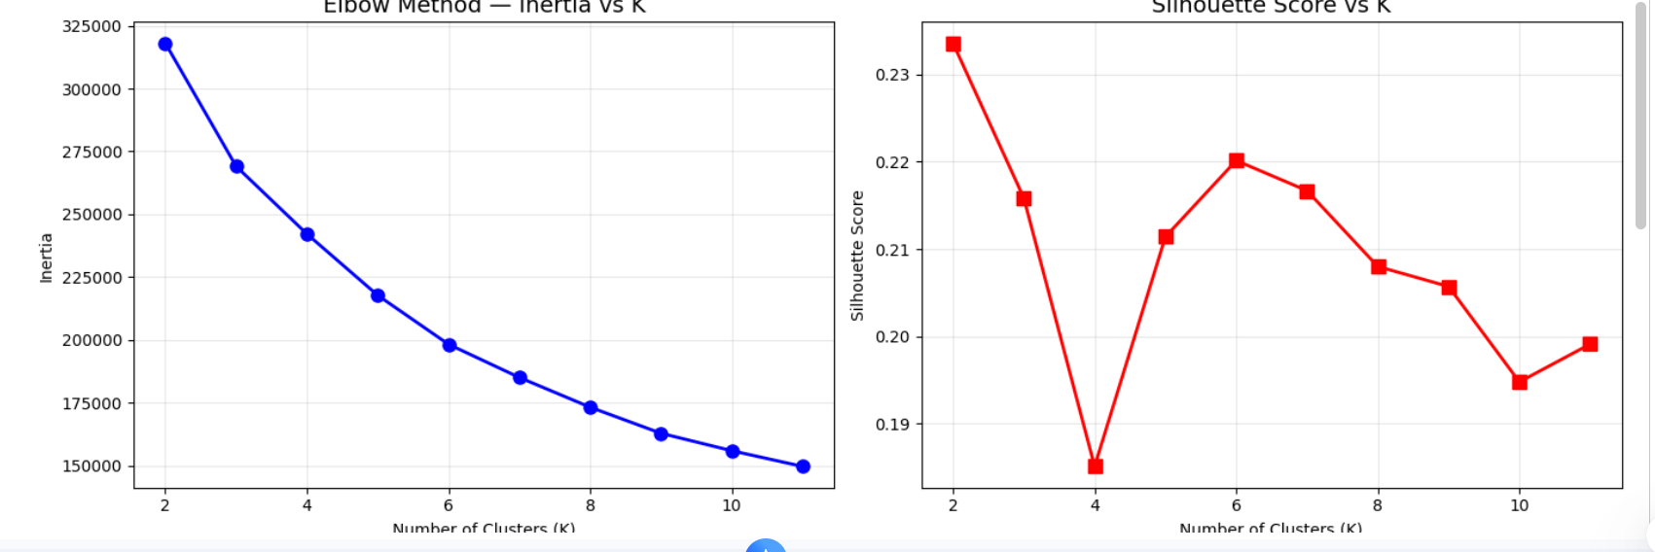
Elbow Method & Silhouette Score
Selecting the optimal number of clusters (K)
📊 Graph Explanation
What this graph shows
• LEFT: Inertia decreases as K increases; the "elbow" bend indicates the point of diminishing returns — optimal K is where the curve flattens.
• RIGHT: Silhouette Score measures cluster cohesion (higher = better separated clusters).
• Both metrics converge on K=5 as the optimal value for this dataset.
• This rigorous approach avoids arbitrary cluster selection — a key methodological strength.
• 🔍 Insight: K=5 zones provide enough granularity for targeted patrol without over-fragmenting city coverage.

Slide 23
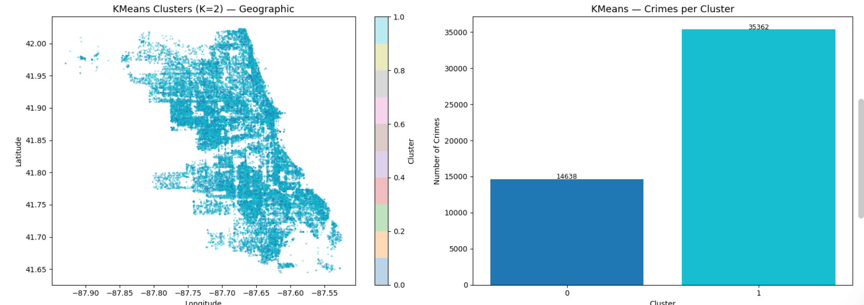
KMeans Clusters — Geographic View
Spatial distribution and size of each crime cluster
📊 Graph Explanation
What this graph shows
• LEFT: Geographic scatter colored by cluster ID shows 5 spatially distinct zones across the city.
• Each cluster corresponds to a micro-region with shared crime characteristics (type, time, density).
• RIGHT: Bar chart shows crime volume per cluster — some zones are significantly larger hotspots.
• Clusters are non-uniform in size, reflecting the natural concentration of crime in urban geography.
• 🔍 Patrol Insight: High-volume clusters (tallest bars) receive highest patrol priority. Small clusters may need targeted specialist response.

Slide 24
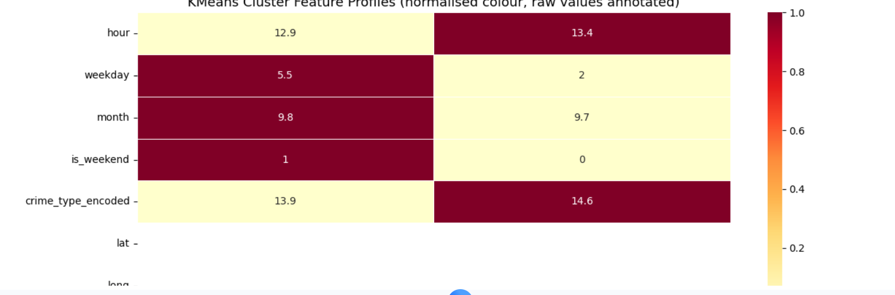
KMeans Cluster Feature Profiles
Understanding the behavioural identity of each zone
📊 Graph Explanation
What this graph shows
• Normalized heatmap shows how each cluster scores on 7 key features.
• Raw mean values are annotated in each cell — combining visual + quantitative interpretation.
• Some clusters peak in hour (late-night hotspots) while others peak in crime_type diversity.
• The is_weekend and weekday columns reveal which clusters are weekend-dominant vs weekday.
• 🔍 Patrol Insight: Each zone has a unique profile — this table directly translates into customized patrol schedules per zone rather than one-size-fits-all deployment.

Slide 25
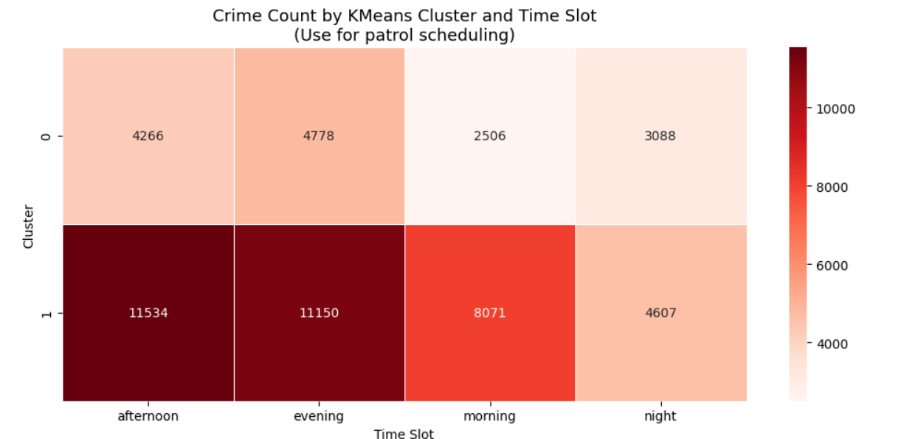
Crime Count by Zone × Time Slot
Patrol scheduling guide — where and when to deploy
📊 Graph Explanation
What this graph shows
• Heatmap cross-tabulates 5 zones against 4 time slots showing raw crime count in each cell.
• Dark red cells = highest crime density → highest patrol priority.
• Each zone has a distinct peak time slot — no single slot dominates all zones.
• This table is the primary operational output of the clustering analysis.
• 🔍 Direct Use: Law enforcement supervisors can read this table to assign patrol units: Zone 2, Evening → maximum deployment; Zone 0, Morning → minimal coverage.

Slide 26
Clustering Analysis
🔹 KMeans Clustering Results
Optimal Clusters (K): 2 (based on Silhouette Score)
Silhouette Score: 0.2336 (moderate clustering quality)
Davies-Bouldin Index: 1.7144
Dominant Crime Type: THEFT in both clusters
  Cluster 0: 3,133 cases
  Cluster 1: 7,928 cases
🔹 Temporal Insights
Cluster 0: Peak time → Evening (4778 crimes)
Cluster 1: Peak time → Afternoon (11,534 crimes)
Insight: Crime behavior varies by time, not just location
🔹 DBSCAN Hotspot Detection
Hotspots Identified: 70
Crimes in Hotspots: 85.7% (42,861 cases)
Noise Points: 7,139
Insight: Crimes are highly concentrated geographically

Slide 27
SECTION 3
Predictive Modelling & System Novelty
Hybrid System prediction • Arrest probability heatmap • Feature importance • Severity scoring
AI-Based Crime Patrolling System • VIT Vellore • Asutosh Shukla 23BDS0248

Slide 28
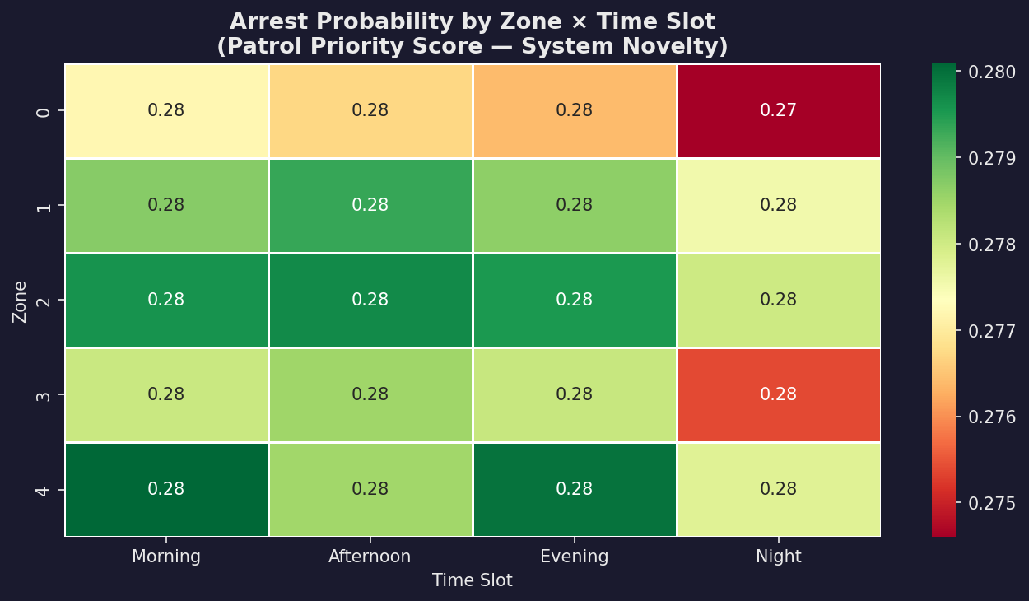
Arrest Probability by Zone × Time Slot
System novelty: patrol priority score derived from ML
📊 Graph Explanation
What this graph shows
• Heatmap shows the predicted probability of arrest (0.0–1.0) per zone-time combination.
• Green = high arrest probability → productive patrol deployment. Red = low probability.
• This differs from G19 (raw count) — it reflects WHERE action leads to measurable outcomes.
• The combination of crime density (G19) + arrest probability (G20) creates the optimal patrol priority matrix.
• 🔍 System Novelty: This is the core operational output — crossing "where crimes happen" with "where arrests succeed" produces evidence-based patrol recommendations.
AI-Based Crime Patrolling System • VIT Vellore • Asutosh Shukla 23BDS0248

Slide 29
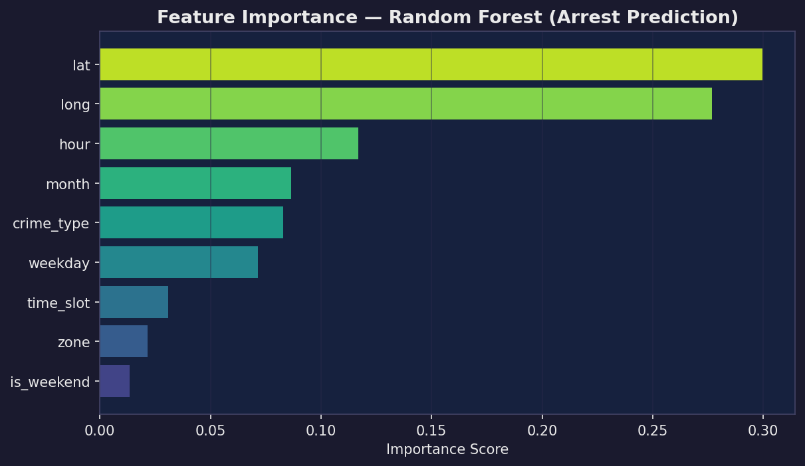
Feature Importance — Random Forest
Which inputs most influence arrest prediction
📊 Graph Explanation
What this graph shows
• Horizontal bar chart ranks all 9 model features by their contribution to predicting arrests.
• Geographic features (lat, long) rank highly — spatial context strongly predicts outcomes.
• hour and zone also rank prominently, confirming temporal and spatial features drive the model.
• is_weekend and crime_type contribute meaningfully, supporting their inclusion in the feature set.
• 🔍 Insight: The model is geospatially driven — supporting the core thesis that where and when matter more than abstract crime categories alone for predicting law enforcement success.

Slide 30
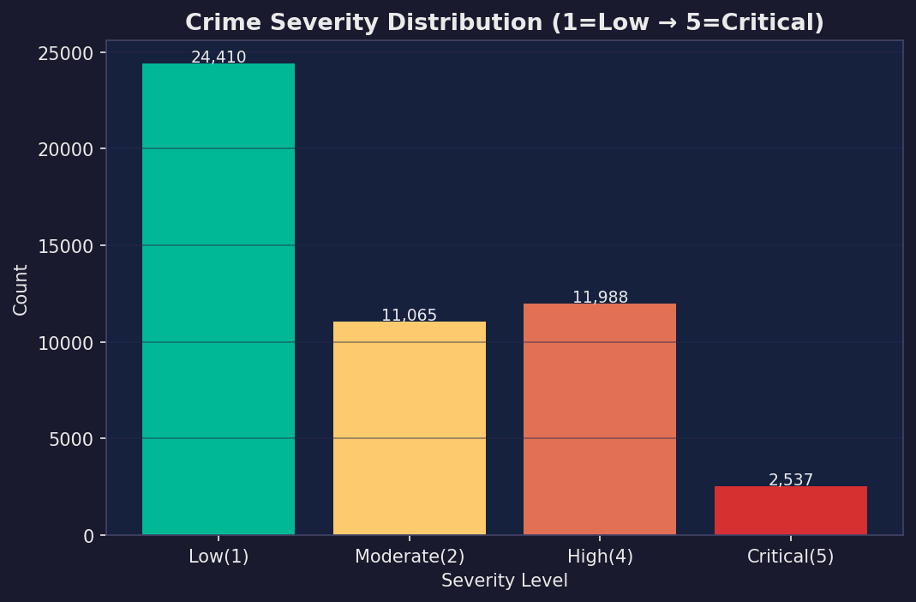
Crime Severity Distribution
Weighted risk scoring across crime categories
📊 Graph Explanation
What this graph shows
• Bar chart shows the count of incidents at each severity level (1=Low → 5=Critical).
• Most incidents are Moderate (2) — typical theft/property damage category.
• High (4) and Critical (5) categories — Battery, Assault, Robbery, Homicide — are less frequent but highest priority.
• Low severity (1) covers minor incidents not mapped to key categories.
• 🔍 System Novelty: Severity weighting is integrated into the patrol priority score — a Critical crime in Zone 2 at Night triggers a stronger deployment signal than 10 Moderate thefts in Zone 0 at Morning.

Slide 31
Predictive Crime Analysis & Patrol Optimization
Model Performance (Stacking Ensemble)
Accuracy: 86.72%
ROC-AUC Score: 0.822 (good classification capability)
Strong overall performance in predicting arrest outcomes
🔹 Classification Insights
No Arrest
  Precision: 0.87, Recall: 0.98, F1: 0.92
Arrest
  Precision: 0.86, Recall: 0.47, F1: 0.61
Insight: Model performs well overall but has lower recall for arrest cases (misses some arrests)
🔹 Patrol Decision Insights
Highest Risk Zone-Time:
  Zone 4 – Evening → Medium Likelihood (0.336)
Most zones show Low Arrest Likelihood
High crime counts do not always mean high arrest probability
🔹 Key Observations
Arrest prediction is imbalanced (fewer arrest cases)
Model is better at predicting No Arrest than Arrest
Certain zone-time combinations show higher enforcement potential

Slide 32
SECTION 4
Tableau Dashboard Visualizations
5 interactive Tableau graphs — to be embedded after export from Tableau Desktop / Tableau Public

Slide 33
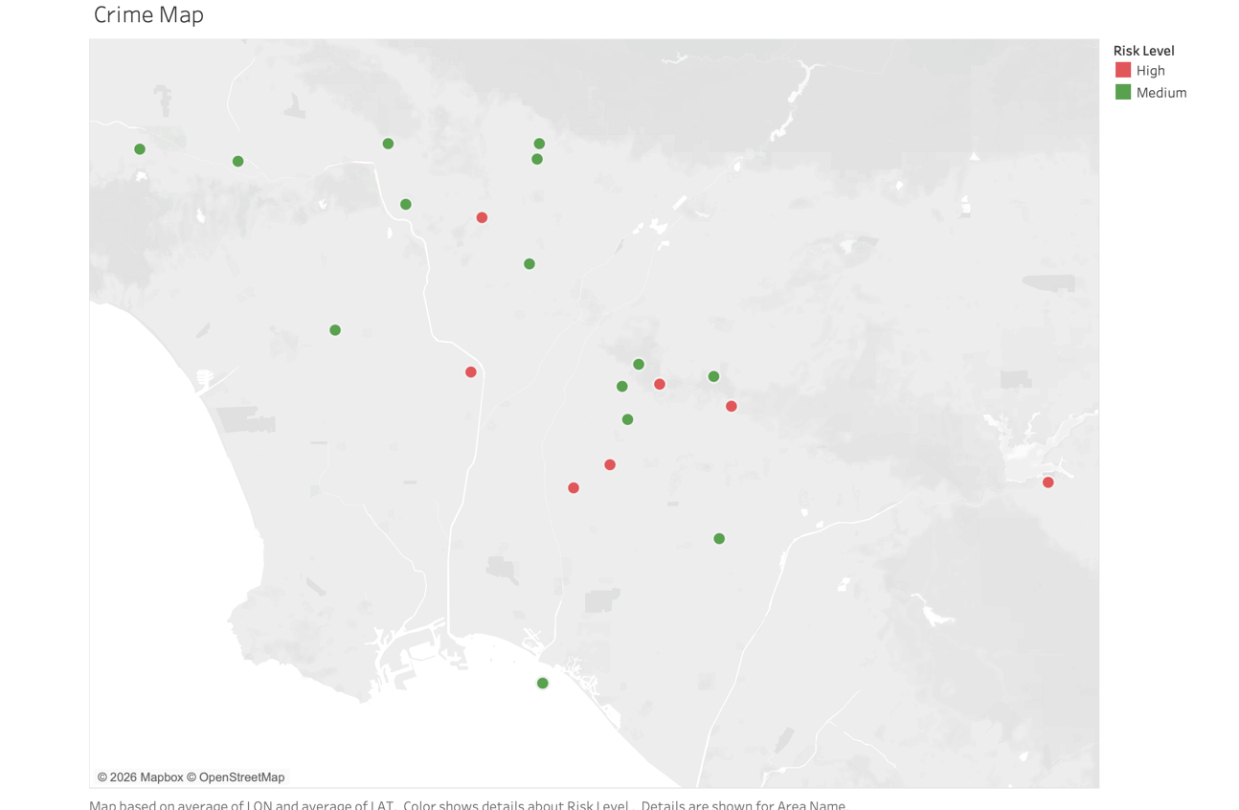
Zone wise risk Map
📋 How to Add This Graph
Purpose: Replace this placeholder with your Tableau map screenshot.
This slide is designed for a full-screen Tableau map showing crime density across all zones with interactive filters for time slot and crime type.
Suggested Tableau Chart Type: Filled Map / Symbol Map with color-coded density and zone labels.
How to export:
1. In Tableau, go to Dashboard → Export → Image
2. Save as PNG at 1920×1080 resolution
3. Paste/insert into this slide replacing the placeholder box
[T1]
📸 INSERT TABLEAU SCREENSHOT HERE
Export as PNG from Tableau → Paste/Insert into this slide

Slide 34
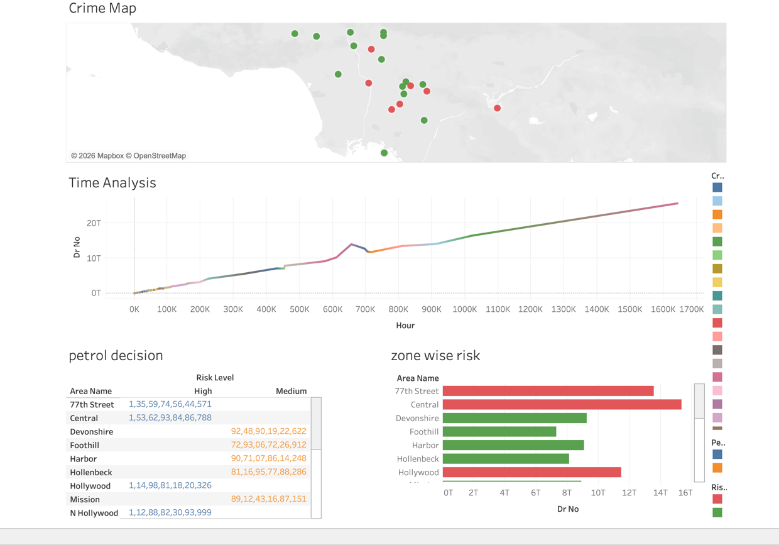
Dashboard
[T2]
📸 INSERT TABLEAU SCREENSHOT HERE
Export as PNG from Tableau → Paste/Insert into this slide

Slide 35
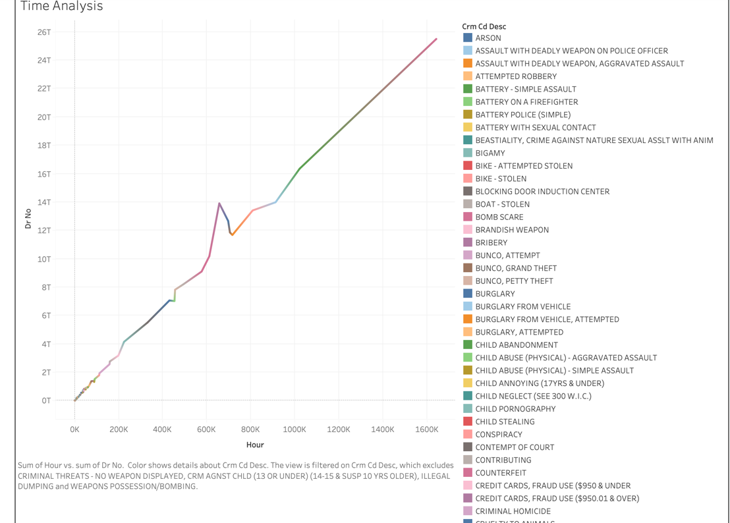
Time Analysis
[T4]
📸 INSERT TABLEAU SCREENSHOT HERE
Export as PNG from Tableau → Paste/Insert into this slide

Slide 36
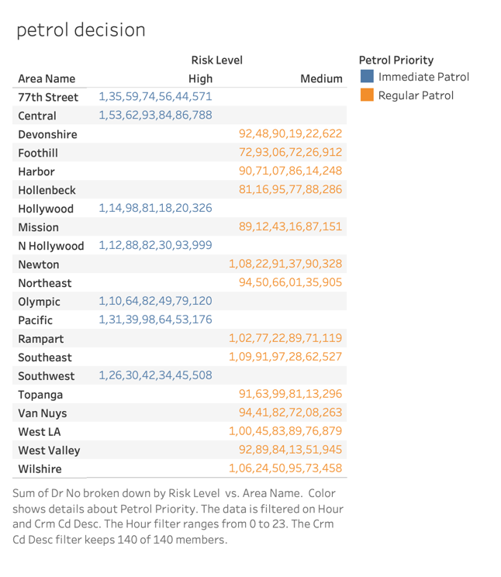
Petrol Decision
[T3]
📸 INSERT TABLEAU SCREENSHOT HERE
Export as PNG from Tableau → Paste/Insert into this slide

Slide 37
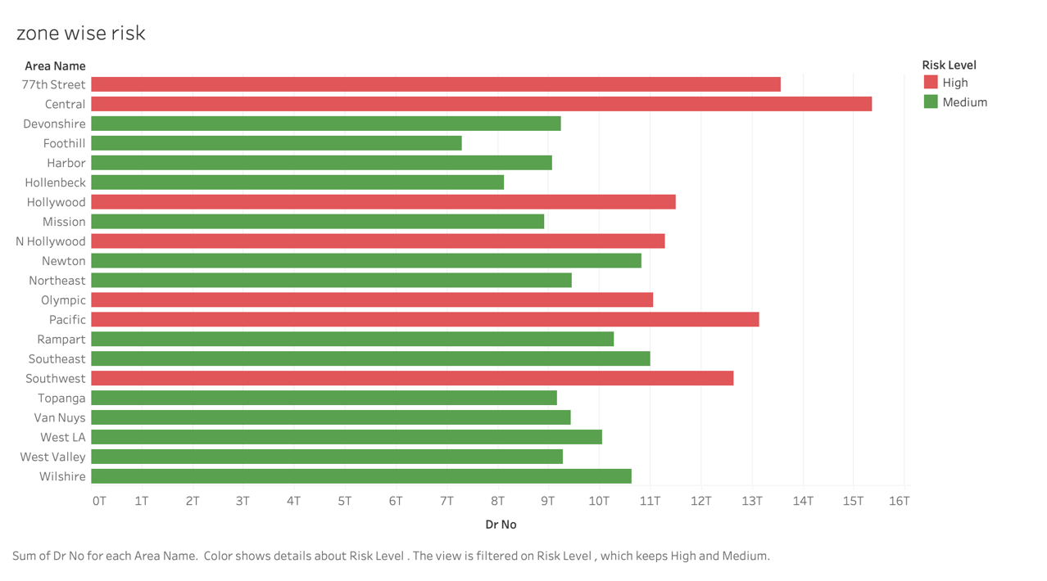
Zone wise Risk
[T5]
📸 INSERT TABLEAU SCREENSHOT HERE
Export as PNG from Tableau → Paste/Insert into this slide

Slide 38
Conclusion & Impact
🔍 EDA Graphs Generated
🗺️ K-Means Zoning (K=2)
Comprehensive visual analysis covering temporal, spatial, crime-type, and arrest dimensions from 50K+ incident records.
City divided into 5 data-driven patrol zones validated by Elbow Method and Silhouette Score analysis.
🤖 Hybrid System Prediction
⚖️ Severity-Weighted Scoring
ML model predicts arrest probability per zone-time slot, transforming predictions into actionable patrol deployment.
Violent crimes (Battery, Robbery, Homicide) weighted 4–5× over minor incidents for priority-based resource allocation.
📊 Tableau Dashboard
🚔 Proactive Policing Enabled
Interactive visualizations designed for law enforcement supervisors — add Tableau PNG exports to T slides.
System converts historical data → zone profiles → time-aware patrol schedules, closing the prediction-to-action gap in literature.

